Slide 1








Bayan Basrana
Mshari
Waleed Althubyani

Slide 2

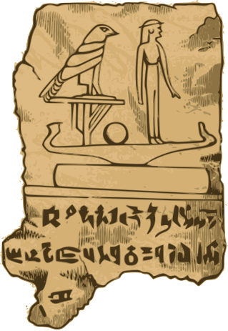




Problem:
1-Fragmented Access to cultural artifacts and heritage data
2-Lack of tools for managing and sharing historical information.
3-Limited engagement between institutions and researchers.
Solution:
Preservia
A centralized platform that allows:
Organizations to manage and display artifacts and events.
Researchers to borrow, explore, and interact.
Admins to monitor and manage platform activities.

Slide 3
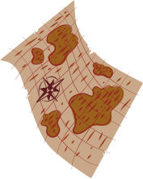

Platform Workflow
Contributors
Researchers
Organizations

Slide 4
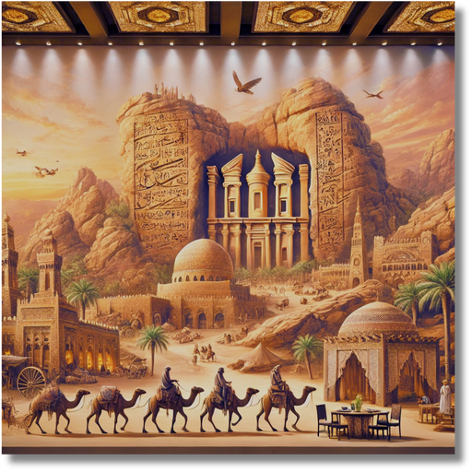

Contributors
1
Registration:
The contributor registers and provides their details.
The platform verifies the contributor’s identity and approves their account.
3
Receive Borrow Requests:
Contributors receive borrow requests from researchers or organizations.
2
Add Artifacts:
The contributor uploads details of the artifact.
including Certificates the authenticity of the artifact.
The platform validates the certificates.
Add Artifact History
4
Contributors can:
Approve the request, updating the artifact status to "borrowed."
Reject the request.

Slide 5
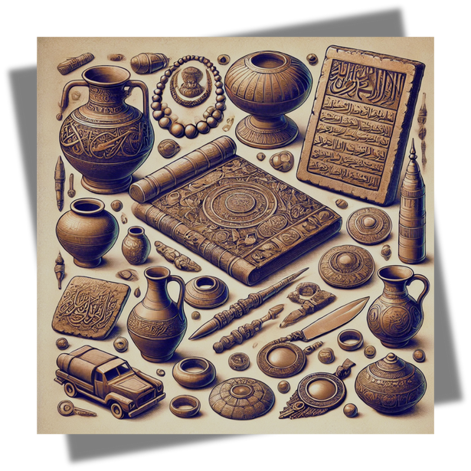
Researcher
1
Registration:
The researcher registers and provides their details, including their license.
The platform verifies the license before approving the account.
3
Researchers can request to borrow artifacts for study
2
Browse Artifacts:
Researchers can view all artifacts on the platform.
They can search based on:
Personal interests (based on previous activities).
4
Researchers can reports regarding artifacts, contributors, or organizations.
Researchers can leave feedback (rating and comments)

Slide 6
Organization
1
Registration:
Organizations register on the platform.
After verification by the platform, their accounts are approved.
3
Feedback:
Organizations can provide feedback.
2
Create Events:
Organizations can organize events
Borrow Requests:
request to borrow artifacts for their events.
If approved, the artifacts are linked to the event and their availability is updated.
4
Reports:
Organizations can submit reports .

Slide 7


Key Competitive Features
Smart Recommendations:
Suggest artifacts to researchers based on prior activity.
Report System:
Allow users to report inappropriate content or misuse.
Feedback System:
Collect ratings and comments to improve item management.
Scheduled Task for Expired Certificates:
task runs daily at midnight to automatically delete expired
certificates from the system.
Scheduled Task for Artifact Availability
task updates the availability of artifacts linked to events once the event has ended.

Slide 8

Thank You
Preservia A digital platform that:
Simplifies cultural heritage management.
Increases collaboration between researchers, contributors, and organizations.
Preserves history for future generations.
"Preserve history, connect cultures, and inspire learning."

